Slide 1
The Short-Run Trade-off between
Inflation and Unemployment
© 2015 Cengage Learning. All Rights Reserved. May not be copied, scanned, or duplicated, in whole or in part, except for use as permitted in a license distributed with a certain product or service or otherwise on a password-protected website for classroom use.

Slide 2
Origins of the Phillips Curve
Phillips curve
  Shows the short-run trade-off
  Between inflation and unemployment
1958, A. W. Phillips
  “The relationship between unemployment and the rate of change of money wages in the United Kingdom, 1861–1957”
    Negative correlation between the rate of unemployment and the rate of inflation
© 2015 Cengage Learning. All Rights Reserved. May not be copied, scanned, or duplicated, in whole or in part, except for use as permitted in a license distributed with a certain product or service or otherwise on a password-protected website for classroom use.

Slide 3
Origins of the Phillips Curve
1960, Paul Samuelson and Robert Solow
  “Analytics of anti-inflation policy”
    Negative correlation between the rate of unemployment and the rate of inflation
Policymakers: Monetary and fiscal policy
  To influence aggregate demand
    Choose any point on Phillips curve
    Trade-off: High unemployment and low inflation
    Or low unemployment and high inflation
© 2015 Cengage Learning. All Rights Reserved. May not be copied, scanned, or duplicated, in whole or in part, except for use as permitted in a license distributed with a certain product or service or otherwise on a password-protected website for classroom use.

Slide 4
Figure 1
The Phillips Curve
Inflation Rate
(percent per year)
B
6%
A
2%
Phillips curve
4%
7%
Unemployment
Rate (percent)
The Phillips curve illustrates a negative association between the inflation rate and the unemployment rate. At point A, inflation is low and unemployment is high. At point B, inflation is high and unemployment is low.
© 2015 Cengage Learning. All Rights Reserved. May not be copied, scanned, or duplicated, in whole or in part, except for use as permitted in a license distributed with a certain product or service or otherwise on a password-protected website for classroom use.

Slide 5
AD, AS, and the Phillips Curve
Phillips curve
  Combinations of inflation and unemployment
  That arise in the short run
  As shifts in the aggregate-demand curve
  Move the economy along the short-run aggregate-supply curve
© 2015 Cengage Learning. All Rights Reserved. May not be copied, scanned, or duplicated, in whole or in part, except for use as permitted in a license distributed with a certain product or service or otherwise on a password-protected website for classroom use.

Slide 6
AD, AS, and the Phillips Curve
An increase in aggregate demand, in the short run
  Higher output
  Higher price level
  Lower unemployment
  Higher inflation
Lower aggregate-demand
  Lower output & Lower price level
  Higher unemployment & Lower inflation
© 2015 Cengage Learning. All Rights Reserved. May not be copied, scanned, or duplicated, in whole or in part, except for use as permitted in a license distributed with a certain product or service or otherwise on a password-protected website for classroom use.

Slide 7
Figure 2
How the Phillips Curve Is Related to the Model of Aggregate Demand and Aggregate Supply
Price
level
(a) The Model of AD and AS
Inflation Rate
(percent
per year)
(b) The Phillips Curve
Short-run
aggregate
supply
B
6%
B
106
A
High aggregate
demand
102
Low aggregate
demand
A
2%
Phillips curve
0
15,000
unemployment
is7%
16,000
unemployment
is 4%
Quantity
of output
0
4%
output
is 16,000
7%
output
is15,000
Unemployment
Rate (percent)
This figure assumes a price level of 100 for the year 2020 and charts possible outcomes for the year 2021. Panel (a) shows the model of aggregate demand and aggregate supply. If aggregate demand is low, the economy is at point A; output is low (15,000), and the price level is low (102). If aggregate demand is high, the economy is at point B; output is high (16,000), and the price level is high (106). Panel (b) shows the implications for the Phillips curve. Point A, which arises when aggregate demand is low, has high unemployment (7%) and low inflation (2%). Point B, which arises when aggregate demand is high, has low unemployment (4%) and high inflation (6%).
© 2015 Cengage Learning. All Rights Reserved. May not be copied, scanned, or duplicated, in whole or in part, except for use as permitted in a license distributed with a certain product or service or otherwise on a password-protected website for classroom use.

Slide 8
The Long-Run Phillips Curve
The long-run Phillips curve
  Is vertical
  Unemployment rate tends toward its normal level
    Natural rate of unemployment
  Unemployment does not depend on money growth and inflation in the long run
© 2015 Cengage Learning. All Rights Reserved. May not be copied, scanned, or duplicated, in whole or in part, except for use as permitted in a license distributed with a certain product or service or otherwise on a password-protected website for classroom use.

Slide 9
The Long-Run Phillips Curve
If the Fed increases the money supply slowly
  Inflation rate is low
  Unemployment – natural rate
If the Fed increases the money supply quickly
  Inflation rate is high
  Unemployment – natural rate
© 2015 Cengage Learning. All Rights Reserved. May not be copied, scanned, or duplicated, in whole or in part, except for use as permitted in a license distributed with a certain product or service or otherwise on a password-protected website for classroom use.

Slide 10
Figure 3
The Long-Run Phillips Curve
Inflation
Rate
Long-run
Phillips curve
High
inflation
B
1. When the Fed increases the growth rate of the money supply, the rate of inflation increases . . .
2. . . . but unemployment
remains at its natural rate
in the long run.
Low
inflation
A
Natural rate of
unemployment
Unemployment
Rate
According to Friedman and Phelps, there is no trade-off between inflation and unemployment in the long run. Growth in the money supply determines the inflation rate. Regardless of the inflation rate, the unemployment rate gravitates toward its natural rate. As a result, the long-run Phillips curve is vertical.
© 2015 Cengage Learning. All Rights Reserved. May not be copied, scanned, or duplicated, in whole or in part, except for use as permitted in a license distributed with a certain product or service or otherwise on a password-protected website for classroom use.

Slide 11
The Long-Run Phillips Curve
The long-run Phillips curve
  Expression of the classical idea of monetary neutrality
Increase in money supply
  Aggregate-demand curve – shifts right
    Price level – increases
    Output – natural level
  Inflation rate – increases
    Unemployment – natural rate
© 2015 Cengage Learning. All Rights Reserved. May not be copied, scanned, or duplicated, in whole or in part, except for use as permitted in a license distributed with a certain product or service or otherwise on a password-protected website for classroom use.

Slide 12
Figure 4
How the LR Phillips Curve Is Related to the Model of AD & AS
Price
level
(a) The Model of AD and AS
(b) The Phillips Curve
Inflation
Rate
Long-run
aggregate supply
Long-run
Phillips curve
1. An increase in
the money supply
increases aggregate
demand . . .
B
B
P₂
3. . . . and
increases the
inflation rate . . .
A
P₁
2. . . . raises the price level . . .
A
AD₂
Aggregate demand, AD₁
0
Natural level
of output
Quantity of output
0
Natural level
of output
Unemployment
Rate
4. . . . but leaves output at its natural level and unemployment at its natural rate.
Panel (a) shows the model of aggregate demand and aggregate supply with a vertical aggregate-supply curve. When expansionary monetary policy shifts the aggregate-demand curve to the right from AD₁ to AD₂, the equilibrium moves from point A to point B. The price level rises from P₁ to P₂, while output remains the same. Panel (b) shows the long-run Phillips curve, which is vertical at the natural rate of unemployment. In the long run, expansionary monetary policy moves the economy from lower inflation (point A) to higher inflation (point B) without changing the rate of unemployment.
© 2015 Cengage Learning. All Rights Reserved. May not be copied, scanned, or duplicated, in whole or in part, except for use as permitted in a license distributed with a certain product or service or otherwise on a password-protected website for classroom use.

Slide 13
The Meaning of “Natural”
Natural rate of unemployment
  Unemployment rate toward which the economy gravitates in the long run
  Not necessarily socially desirable
  Not constant over time
Labor-market policies
  Affect the natural rate of unemployment
  Shift the Phillips curve
© 2015 Cengage Learning. All Rights Reserved. May not be copied, scanned, or duplicated, in whole or in part, except for use as permitted in a license distributed with a certain product or service or otherwise on a password-protected website for classroom use.

Slide 14
The Meaning of “Natural”
Policy change - reduce the natural rate of unemployment
  Long-run Phillips curve shifts left
  Long-run aggregate-supply curve shifts right
  For any given rate of money growth and inflation
    Lower unemployment
    Higher output
© 2015 Cengage Learning. All Rights Reserved. May not be copied, scanned, or duplicated, in whole or in part, except for use as permitted in a license distributed with a certain product or service or otherwise on a password-protected website for classroom use.

Slide 15
Reconciling Theory and Evidence
Expected inflation
  Determines the position of short-run aggregate-supply curve
Short run
  The Fed can take
    Expected inflation and short-run aggregate-supply curve
    As already determined
© 2015 Cengage Learning. All Rights Reserved. May not be copied, scanned, or duplicated, in whole or in part, except for use as permitted in a license distributed with a certain product or service or otherwise on a password-protected website for classroom use.

Slide 16
Reconciling Theory and Evidence
Short run
  Money supply changes
    Aggregate-demand curve shifts along a given short-run aggregate-supply curve
    Unexpected fluctuations in
      Output and prices
      Unemployment and inflation
    Downward-sloping Phillips curve
© 2015 Cengage Learning. All Rights Reserved. May not be copied, scanned, or duplicated, in whole or in part, except for use as permitted in a license distributed with a certain product or service or otherwise on a password-protected website for classroom use.

Slide 17
Reconciling Theory and Evidence
Long run
  People - expect whatever inflation rate the Fed chooses to produce
    Nominal wages - adjust to keep pace with inflation
    Long-run aggregate-supply curve is vertical
© 2015 Cengage Learning. All Rights Reserved. May not be copied, scanned, or duplicated, in whole or in part, except for use as permitted in a license distributed with a certain product or service or otherwise on a password-protected website for classroom use.

Slide 18
Reconciling Theory and Evidence
Long run
  Money supply changes
    Aggregate-demand curve shifts along a vertical long-run aggregate-supply curve
    No fluctuations in
      Output and unemployment
    Unemployment – natural rate
  Vertical long-run Phillips curve
© 2015 Cengage Learning. All Rights Reserved. May not be copied, scanned, or duplicated, in whole or in part, except for use as permitted in a license distributed with a certain product or service or otherwise on a password-protected website for classroom use.

Slide 19
The Short-Run Phillips Curve
Unemployment rate =
  = Natural rate of unemployment –
  - a(Actual inflation – Expected inflation)
  Where a - parameter that measures how much unemployment responds to unexpected inflation
© 2015 Cengage Learning. All Rights Reserved. May not be copied, scanned, or duplicated, in whole or in part, except for use as permitted in a license distributed with a certain product or service or otherwise on a password-protected website for classroom use.

Slide 20
The Short-Run Phillips Curve
No stable short-run Phillips curve
  Each short-run Phillips curve
    Reflects a particular expected rate of inflation
  Expected inflation – changes
    Short-run Phillips curve shifts
© 2015 Cengage Learning. All Rights Reserved. May not be copied, scanned, or duplicated, in whole or in part, except for use as permitted in a license distributed with a certain product or service or otherwise on a password-protected website for classroom use.

Slide 21
Figure 5
How Expected Inflation Shifts the Short-Run Phillips Curve
Inflation
Rate
Long-run
Phillips curve
2. . . . but in the long run, expected
inflation rises, and the short-run
Phillips curve shifts to the right.
B
C
1. Expansionary policy moves
the economy up along the
short-run Phillips curve . . .
A
Short-run Phillips curve with high expected inflation
Short-run Phillips curve with low expected inflation
Natural rate of
unemployment
Unemployment Rate
The higher the expected rate of inflation, the higher the curve representing the short-run trade-off between inflation and unemployment. At point A, expected inflation and actual inflation are equal at a low rate, and unemployment is at its natural rate. If the Fed pursues an expansionary monetary policy, the economy moves from point A to point B in the short run. At point B, expected inflation is still low, but actual inflation is high. Unemployment is below its natural rate. In the long run, expected inflation rises, and the economy moves to point C. At point C, expected inflation and actual inflation are both high, and unemployment is back to its natural rate.
© 2015 Cengage Learning. All Rights Reserved. May not be copied, scanned, or duplicated, in whole or in part, except for use as permitted in a license distributed with a certain product or service or otherwise on a password-protected website for classroom use.

Slide 22
Natural-Rate Hypothesis
Natural-rate hypothesis
  Unemployment - eventually returns to its normal/natural rate
  Regardless of the rate of inflation
Late 1960s (short-run), policies:
  Expand AD for goods and services
  Expansionary fiscal policy
    Government spending rose
      Vietnam War
© 2015 Cengage Learning. All Rights Reserved. May not be copied, scanned, or duplicated, in whole or in part, except for use as permitted in a license distributed with a certain product or service or otherwise on a password-protected website for classroom use.

Slide 23
Natural-Rate Hypothesis
Late 1960s (short-run), policies:
  Monetary policy
    The Fed – try to hold down interest rates
    Money supply – rose 13% per year
    High inflation (5-6% per year)
    Unemployment increased
    Trade-off
© 2015 Cengage Learning. All Rights Reserved. May not be copied, scanned, or duplicated, in whole or in part, except for use as permitted in a license distributed with a certain product or service or otherwise on a password-protected website for classroom use.

Slide 24
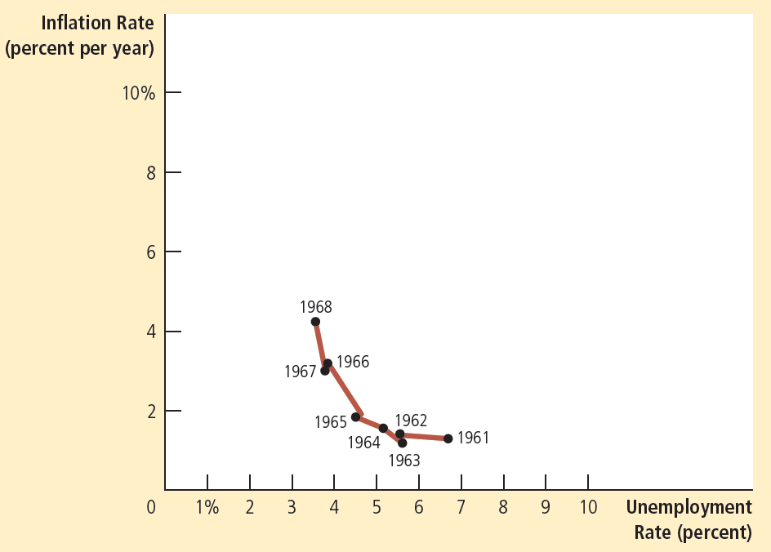

Figure 6
The Phillips Curve in the 1960s
This figure uses annual data from 1961 to 1968 on the unemployment rate and on the inflation rate (as measured by the GDP deflator) to show the negative relationship between inflation and unemployment.
© 2015 Cengage Learning. All Rights Reserved. May not be copied, scanned, or duplicated, in whole or in part, except for use as permitted in a license distributed with a certain product or service or otherwise on a password-protected website for classroom use.

Slide 25
Natural-Rate Hypothesis
By the late 1970s (long-run)
  Inflation – stayed high
    People’s expectations of inflation caught up with reality
  Unemployment – natural rate
  No trade-off between unemployment and inflation in the long-run
© 2015 Cengage Learning. All Rights Reserved. May not be copied, scanned, or duplicated, in whole or in part, except for use as permitted in a license distributed with a certain product or service or otherwise on a password-protected website for classroom use.

Slide 26
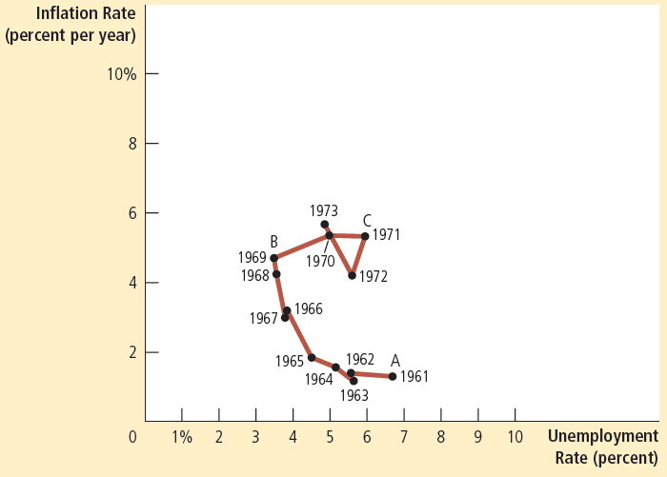
Figure 7
The Breakdown of the Phillips Curve
This figure shows annual data from 1961 to 1973 on the unemployment rate and on the inflation rate (as measured by the GDP deflator). The Phillips curve of the 1960s breaks down in the early 1970s, just as Friedman and Phelps had predicted. Notice that the points labeled A, B, and C in this figure correspond roughly to the points in Figure 5.
© 2015 Cengage Learning. All Rights Reserved. May not be copied, scanned, or duplicated, in whole or in part, except for use as permitted in a license distributed with a certain product or service or otherwise on a password-protected website for classroom use.

Slide 27
Shifts in Phillips Curve
Supply shock
  Event that directly alters firms’ costs and prices
  Shifts economy’s aggregate-supply curve
  Shifts the Phillips curve
© 2015 Cengage Learning. All Rights Reserved. May not be copied, scanned, or duplicated, in whole or in part, except for use as permitted in a license distributed with a certain product or service or otherwise on a password-protected website for classroom use.

Slide 28
Shifts in Phillips Curve
Increase in oil price
  Aggregate-supply curve shifts left
  Stagflation
    Lower output
    Higher prices
  Short-run Phillips curve shifts right
    Higher unemployment
    Higher inflation
© 2015 Cengage Learning. All Rights Reserved. May not be copied, scanned, or duplicated, in whole or in part, except for use as permitted in a license distributed with a certain product or service or otherwise on a password-protected website for classroom use.

Slide 29
Figure 8
An Adverse Shock to Aggregate Supply
(a) The Model of AD and AS
(b) The Phillips Curve
Price
level
1. An adverse shift
in aggregate supply . . .
Inflation
Rate
4. . . . giving policymakers
a less favorable trade-off between unemployment and inflation.
3. . . . and raises
the price level . . .
AS₂
Aggregate
supply, AS₁
B
P₂
B
A
P₁
2. . . . lowers output . . .
A
Aggregate
demand
PC₂
Phillips curve, PC₁
0
Y₂
Y₁
Quantity of output
0
Unemployment Rate
Panel (a) shows the model of aggregate demand and aggregate supply. When the AS curve shifts to the left from AS₁ to AS₂, the equilibrium moves from point A to point B. Output falls from Y₁ to Y₂, and the price level rises from P₁ to P₂. Panel (b) shows the short-run trade-off between inflation and unemployment. The adverse shift in aggregate supply moves the economy from a point with lower unemployment and lower inflation (point A) to a point with higher unemployment and higher inflation (point B). The short-run Phillips curve shifts to the right from PC₁ to PC₂. Policymakers now face a worse set of options for inflation and unemployment..
© 2015 Cengage Learning. All Rights Reserved. May not be copied, scanned, or duplicated, in whole or in part, except for use as permitted in a license distributed with a certain product or service or otherwise on a password-protected website for classroom use.

Slide 30
Shifts in Phillips Curve
Increase in oil price
  Short-run Phillips curve shifts right
    If temporary – revert back
    If permanent – needs government intervention
  1970s, 1980s, U.S.
    The Fed – higher money growth
      Increase AD
      To accommodate the adverse supply shock
      Higher inflation
© 2015 Cengage Learning. All Rights Reserved. May not be copied, scanned, or duplicated, in whole or in part, except for use as permitted in a license distributed with a certain product or service or otherwise on a password-protected website for classroom use.

Slide 31
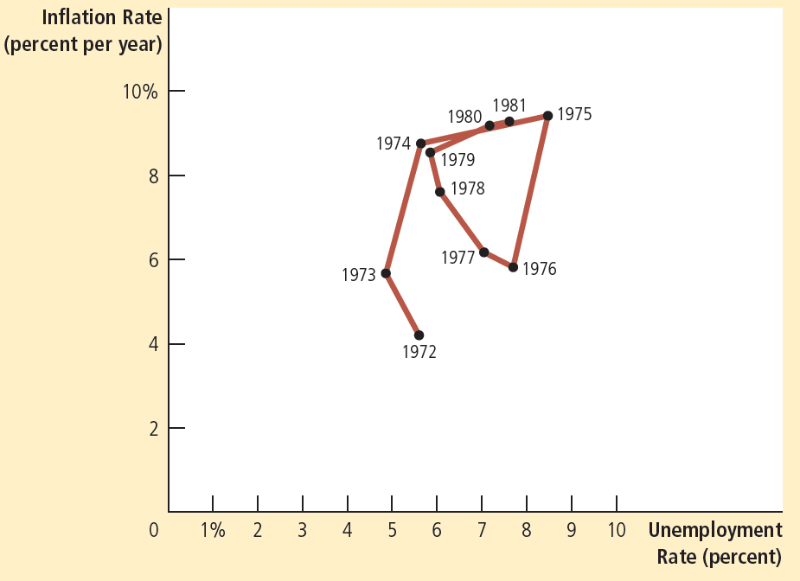
Figure 9
The Supply Shocks of the 1970s
This figure shows annual data from 1972 to 1981 on the unemployment rate and on the inflation rate (as measured by the GDP deflator). In the periods 1973–1975 and 1978–1981, increases in world oil prices led to higher inflation and higher unemployment.
© 2015 Cengage Learning. All Rights Reserved. May not be copied, scanned, or duplicated, in whole or in part, except for use as permitted in a license distributed with a certain product or service or otherwise on a password-protected website for classroom use.

Slide 32
The Cost of Reducing Inflation
Disinflation
  Reduction in the rate of inflation
Deflation
  Reduction in the price level
Fed Chairman: Paul Volcker
October 1979
  OPEC – second oil shock
  The Fed – policy of disinflation
© 2015 Cengage Learning. All Rights Reserved. May not be copied, scanned, or duplicated, in whole or in part, except for use as permitted in a license distributed with a certain product or service or otherwise on a password-protected website for classroom use.

Slide 33
The Cost of Reducing Inflation
Contractionary monetary policy
  Aggregate demand – contracts
    Higher unemployment
    Lower inflation
  Over time
    Phillips curve shifts left
      Lower inflation
      Unemployment – natural rate
© 2015 Cengage Learning. All Rights Reserved. May not be copied, scanned, or duplicated, in whole or in part, except for use as permitted in a license distributed with a certain product or service or otherwise on a password-protected website for classroom use.

Slide 34
Figure 10
Disinflationary Monetary Policy in the Short Run & Long Run
Inflation
Rate
Long-run
Phillips curve
1. Contractionary policy moves
the economy down along the
short-run Phillips curve . . .
A
C
B
Short-run Phillips curve with high expected inflation
2. . . . but in the long run, expected
inflation falls, and the short-run
Phillips curve shifts to the left
Short-run Phillips curve
with low expected inflation
Natural rate of
unemployment
Unemployment Rate
When the Fed pursues contractionary monetary policy to reduce inflation, the economy moves along a short-run Phillips curve from point A to point B. Over time, expected inflation falls, and the short-run Phillips curve shifts downward. When the economy reaches point C, unemployment is back at its natural rate.
© 2015 Cengage Learning. All Rights Reserved. May not be copied, scanned, or duplicated, in whole or in part, except for use as permitted in a license distributed with a certain product or service or otherwise on a password-protected website for classroom use.

Slide 35
The Cost of Reducing Inflation
Sacrifice ratio
  Number of percentage points of annual output lost in the process of reducing inflation by 1 percentage point
  Typical estimate: 5
    For each percentage point that inflation is reduced
    5 percent of annual output must be sacrificed in the transition
© 2015 Cengage Learning. All Rights Reserved. May not be copied, scanned, or duplicated, in whole or in part, except for use as permitted in a license distributed with a certain product or service or otherwise on a password-protected website for classroom use.

Slide 36
The Cost of Reducing Inflation
Rational expectations
  People optimally use all information they have
  Including information about government policies
  When forecasting the future
© 2015 Cengage Learning. All Rights Reserved. May not be copied, scanned, or duplicated, in whole or in part, except for use as permitted in a license distributed with a certain product or service or otherwise on a password-protected website for classroom use.

Slide 37
The Cost of Reducing Inflation
Possibility of costless disinflation
  Rational expectations – smaller sacrifice ratio
  Government – credible commitment to a policy of low inflation
    People: lower their expectations of inflation
    Short-run Phillips curve - shift downward
    Economy - low inflation quickly
      Without temporarily high unemployment and low output
© 2015 Cengage Learning. All Rights Reserved. May not be copied, scanned, or duplicated, in whole or in part, except for use as permitted in a license distributed with a certain product or service or otherwise on a password-protected website for classroom use.

Slide 38
The Cost of Reducing Inflation
The Volker disinflation
  Peak inflation: 10%
    Sacrifice ratio = 5
      Reducing inflation – great cost
    Rational expectations
      Reducing inflation – smaller cost
  1984 inflation : 4% due to Monetary policy
    Cost: recession
      High unemployment: 10%
      Low output
© 2015 Cengage Learning. All Rights Reserved. May not be copied, scanned, or duplicated, in whole or in part, except for use as permitted in a license distributed with a certain product or service or otherwise on a password-protected website for classroom use.

Slide 39
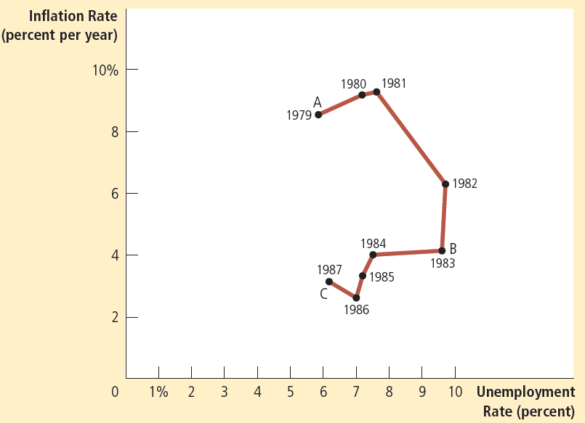
Figure 11
The Volcker Disinflation
This figure shows annual data from 1979 to 1987 on the unemployment rate and on the inflation rate (as measured by the GDP deflator). The reduction in inflation during this period came at the cost of very high unemployment in 1982 and 1983. Note that the points labeled A, B, and C in this figure correspond roughly to the points in Figure 10.
© 2015 Cengage Learning. All Rights Reserved. May not be copied, scanned, or duplicated, in whole or in part, except for use as permitted in a license distributed with a certain product or service or otherwise on a password-protected website for classroom use.

Slide 40
The Cost of Reducing Inflation
Rational expectations
  Costless disinflation
Volker disinflation
  Cost – not as large as predicted
  The public did not believe him
    When he announced monetary policy to reduce inflation
© 2015 Cengage Learning. All Rights Reserved. May not be copied, scanned, or duplicated, in whole or in part, except for use as permitted in a license distributed with a certain product or service or otherwise on a password-protected website for classroom use.

Slide 41
The Cost of Reducing Inflation
The Greenspan era
  Alan Greenspan – chair of the Fed, 1987
  Favorable supply shock (OPEC, 1986)
    Falling inflation
    Falling unemployment
  1989-1990: high inflation and low unemployment
    The Fed – raised interest rates
      Contracted aggregate demand
© 2015 Cengage Learning. All Rights Reserved. May not be copied, scanned, or duplicated, in whole or in part, except for use as permitted in a license distributed with a certain product or service or otherwise on a password-protected website for classroom use.

Slide 42
The Cost of Reducing Inflation
The Greenspan era
  1990s – economic prosperity
    Prudent monetary policy
  2001: recession
    Depressed aggregate demand
    Expansionary fiscal and monetary policy
  By early 2005, unemployment - close to the natural rate
© 2015 Cengage Learning. All Rights Reserved. May not be copied, scanned, or duplicated, in whole or in part, except for use as permitted in a license distributed with a certain product or service or otherwise on a password-protected website for classroom use.

Slide 43
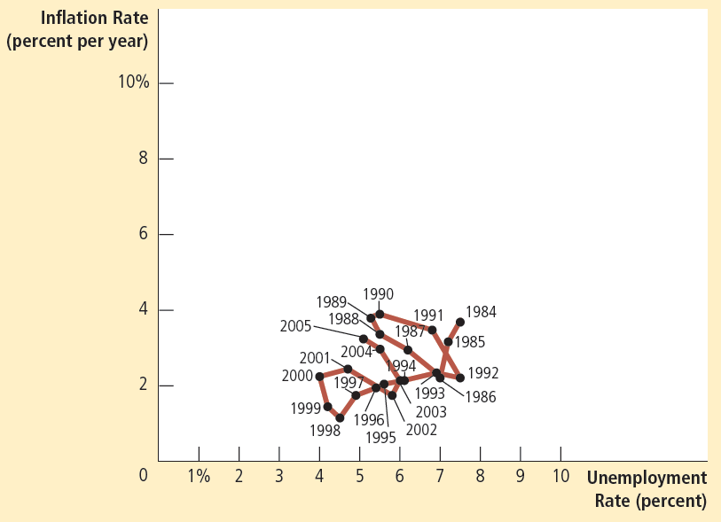
Figure 12
The Greenspan Era
This figure shows annual data from 1984 to 2005 on the unemployment rate and on the inflation rate (as measured by the GDP deflator). During most of this period, Alan Greenspan was chairman of the Federal Reserve. Fluctuations in inflation and unemployment were relatively small.
© 2015 Cengage Learning. All Rights Reserved. May not be copied, scanned, or duplicated, in whole or in part, except for use as permitted in a license distributed with a certain product or service or otherwise on a password-protected website for classroom use.

Slide 44
The Financial Crisis
2006, Ben Bernanke – chair of the Fed
1995-2006: booming housing market
  Average U.S. house prices more than doubled
2006 – 2009
  House prices fell by about one third
  Declines in household wealth
  Financial institutions – difficulties
    Mortgage-backed securities
© 2015 Cengage Learning. All Rights Reserved. May not be copied, scanned, or duplicated, in whole or in part, except for use as permitted in a license distributed with a certain product or service or otherwise on a password-protected website for classroom use.

Slide 45
The Financial Crisis
Financial crisis
  Large decline in aggregate demand
  Steep increase in unemployment
2007 to 2009, decline in AD
  Raised unemployment
  Reduced the rate of inflation (from 3 to 1%)
2010 to 2012, slow recovery
  Unemployment fell
  The rate of inflation rose (from 1 to 2%)
© 2015 Cengage Learning. All Rights Reserved. May not be copied, scanned, or duplicated, in whole or in part, except for use as permitted in a license distributed with a certain product or service or otherwise on a password-protected website for classroom use.

Slide 46
The Financial Crisis
The very low inflation of 2009 and 2010
  Did not reduced expected inflation
  Expected inflation: steady at about 2%
  Short-run Phillips curve relatively stable
  The Fed, past 20 years - a lot of credibility in its commitment to keep inflation at 2%
    Expected inflation and the position of the short-run Phillips curve reacted less to the dramatic short-run events
© 2015 Cengage Learning. All Rights Reserved. May not be copied, scanned, or duplicated, in whole or in part, except for use as permitted in a license distributed with a certain product or service or otherwise on a password-protected website for classroom use.

Slide 47
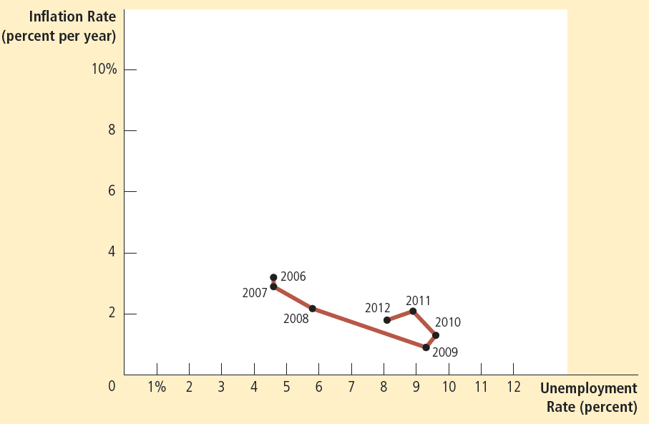

Figure 13
The Phillips Curve during and after the Recession
of 2008–2009
This figure shows annual data from 2006 to 2012 on the unemployment rate and on the inflation rate (as measured by the GDP deflator). A financial crisis caused aggregate demand to plummet, leading to much higher unemployment and pushing inflation down to a very low level.
© 2015 Cengage Learning. All Rights Reserved. May not be copied, scanned, or duplicated, in whole or in part, except for use as permitted in a license distributed with a certain product or service or otherwise on a password-protected website for classroom use.

